Slide 1
CLASS 6/7
Computer Vision

Slide 2
Convnets - Primary Element of CV using Deep Learning
Convnets: Models built using Convolution Layers
Convolution: A mathematical concept which involved CONVOLVING of one matrix with an other matrix. (also applicable to Tensors.)
Why CONVNETS As we have seen in minist dataset, there were 784 features in the input layer. Imagin if an image is 225 x 225 x 3, it would equate to 151,875.
Again imagin the number of weights if the model contains only one hidden layer of 1024 size ... makies whooping 155.5 Million parameters in just a single hidden layerd model.
--Thats too much for computer resources, while the model would not be able to do something appreceable.
So Convnets came to rescue and paved the way for success of Deep Learning starting off with 2013-2015 ILSCVR competitions.

Slide 3
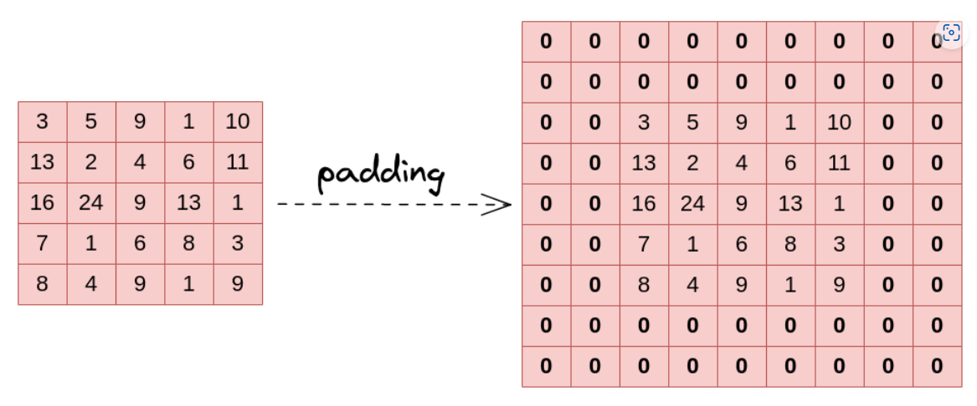
Padding

Slide 4
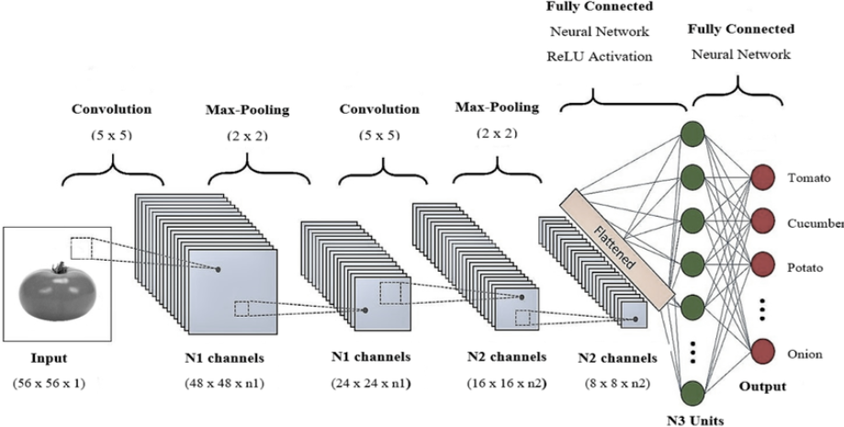
Convnet

Slide 5
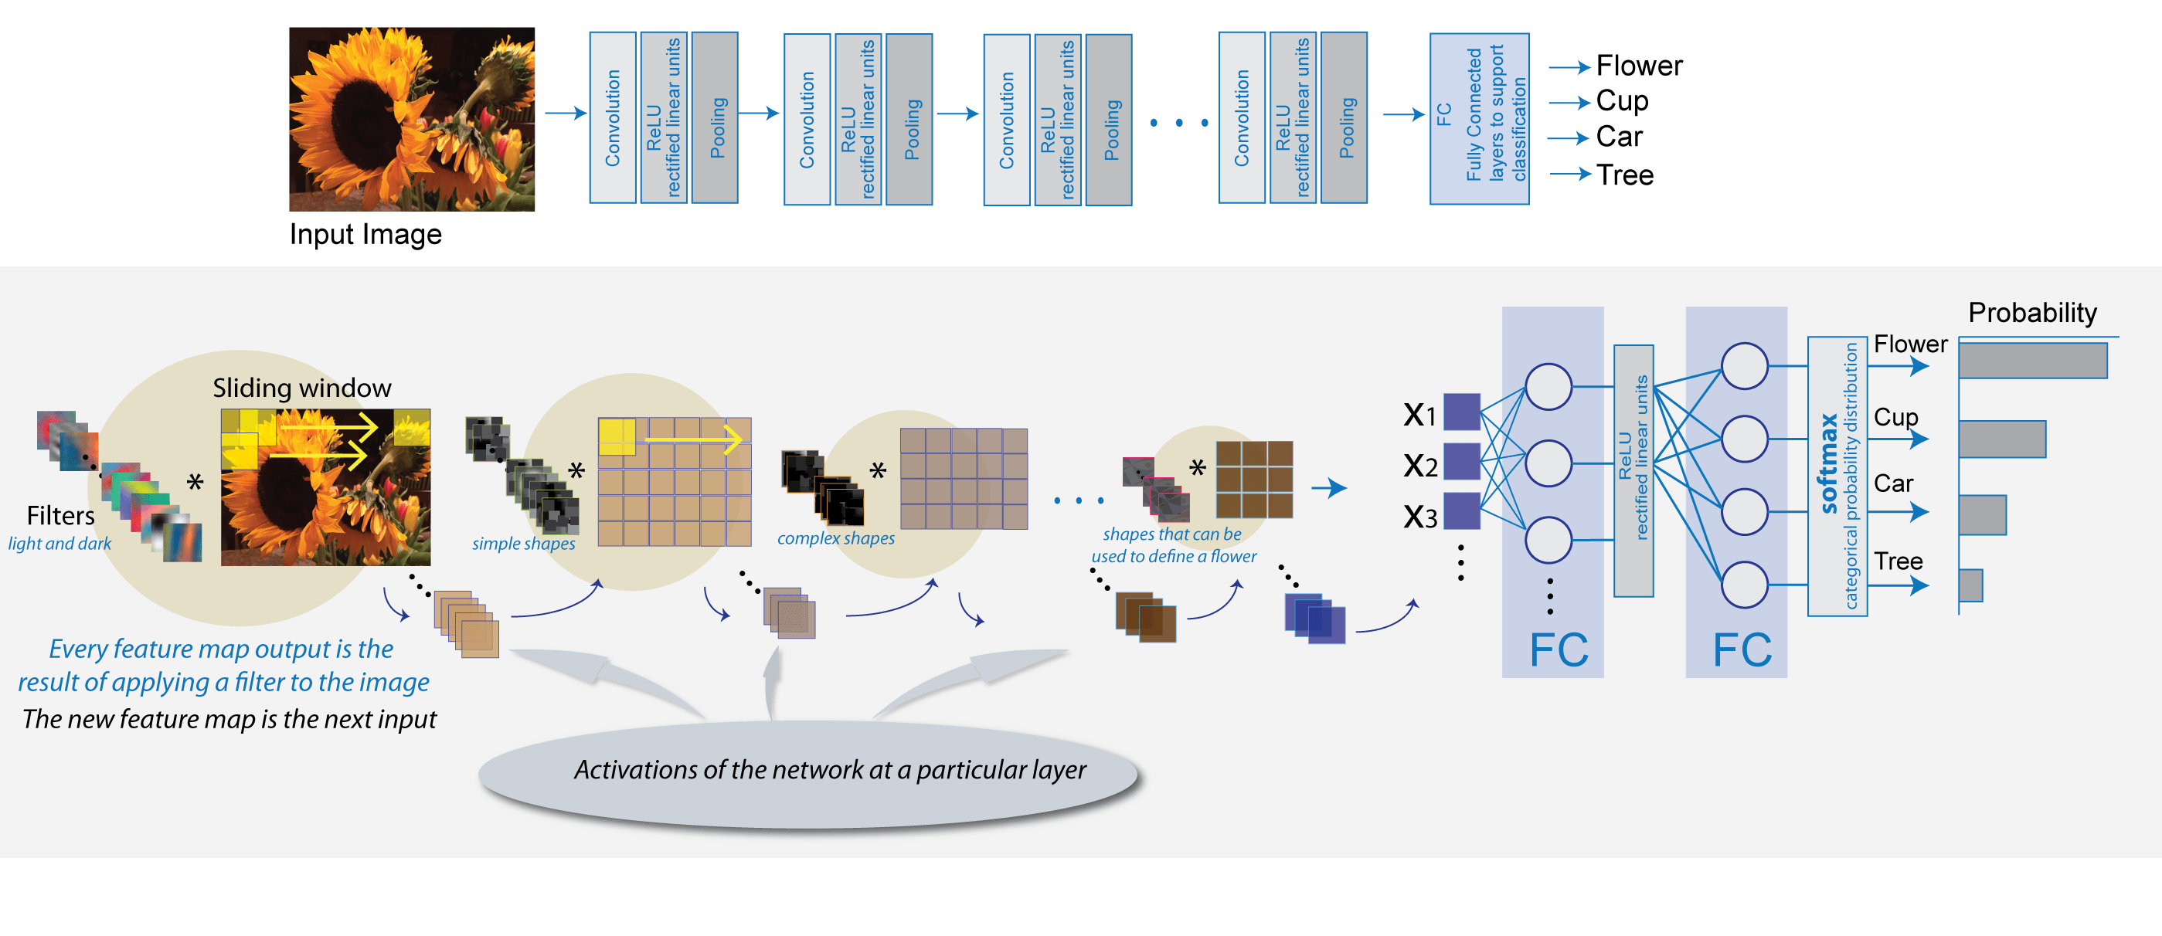

Slide 6
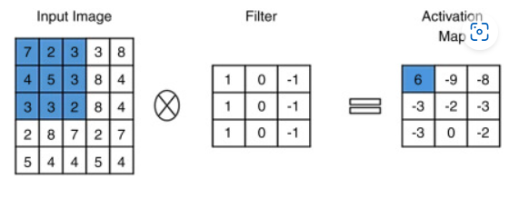
Concept of Convolution Filters
code
7*1 + 2*0 + 3*-1 =4
4*1 + 5*0 + 3*-1= 1 sum al 3 rows=6
3*1 + 3*0 + 2*-1 = 1

Slide 7
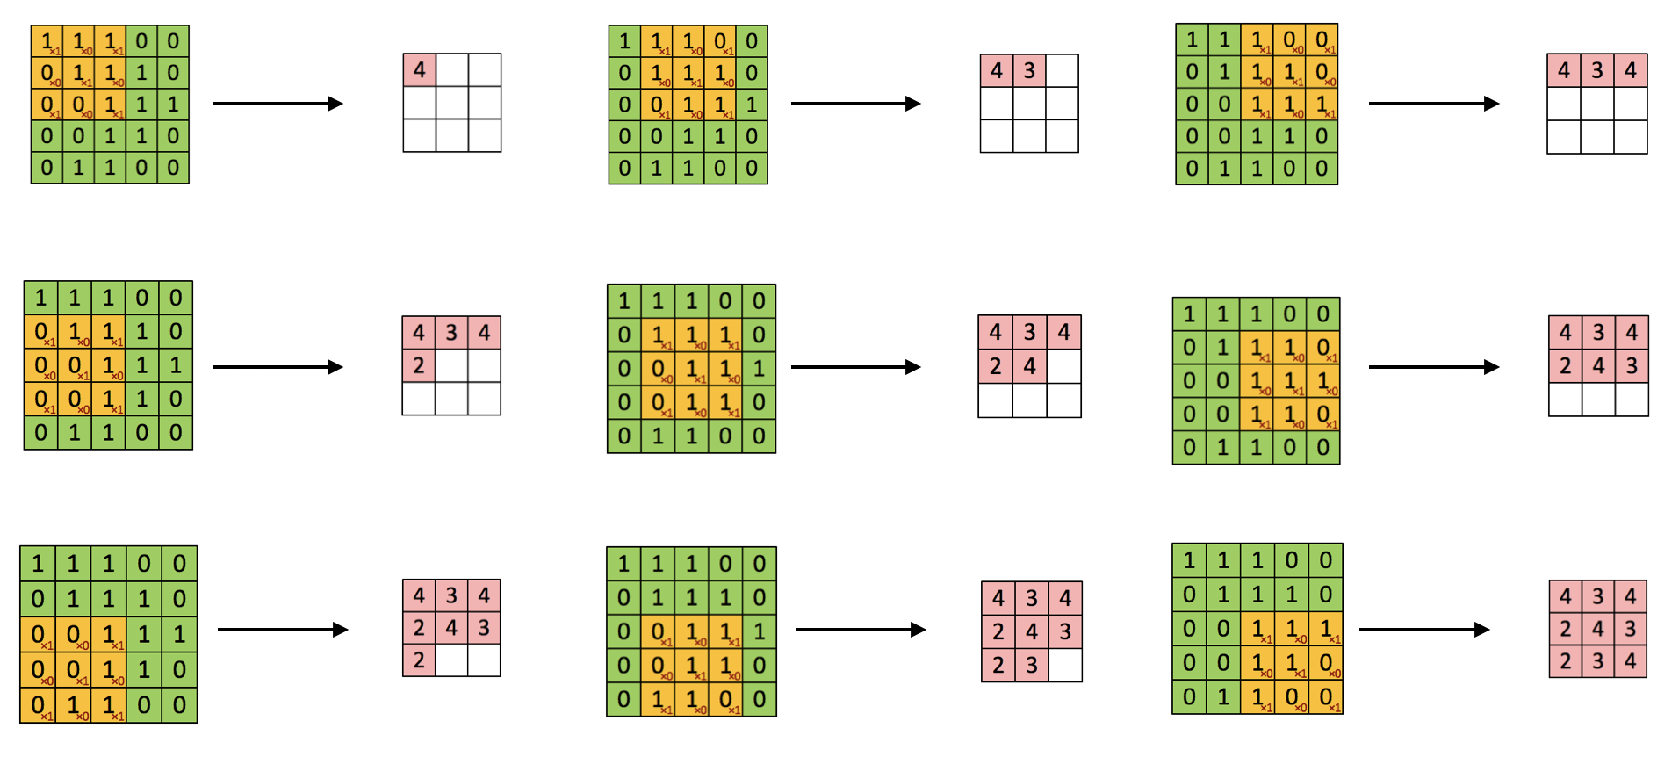

Slide 8
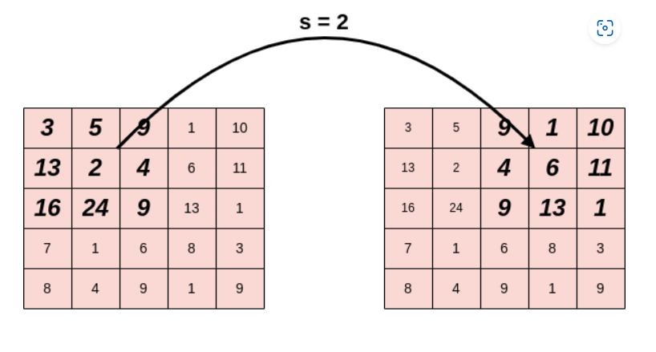
Strides

Slide 9
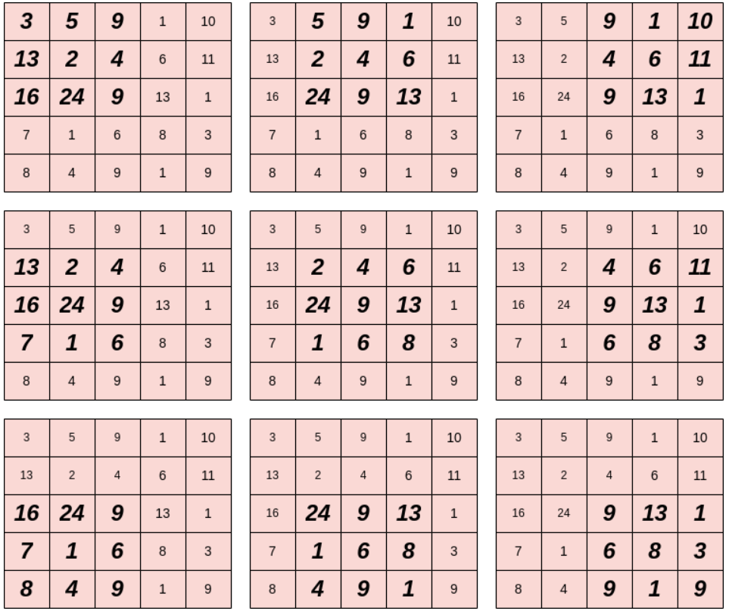
Source Image Successive Patches

Slide 10
CONVOLUTION

Slide 11
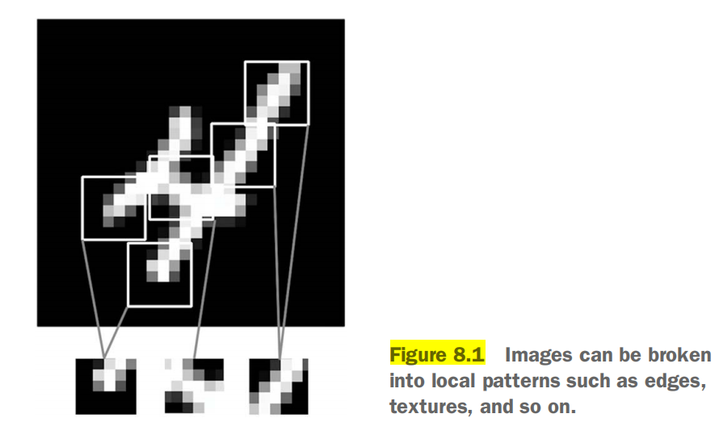
The Convolution Operation
2 main properties
Translation Invariant (Location independant)
Learn Spatial Hirerchies of patterns (learn increasingly difficult patterns)

Slide 12
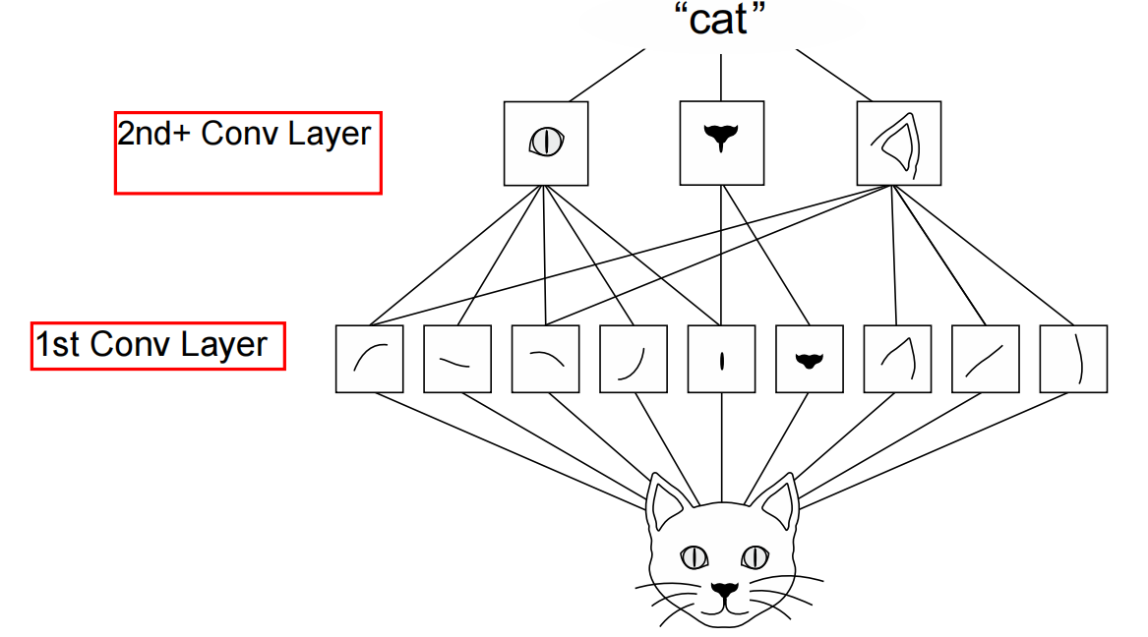
Spatial Hirerchary

Slide 13
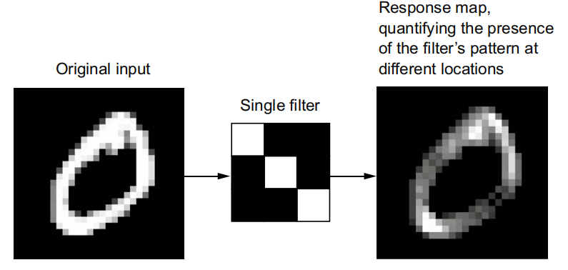
Feature Map, Filter & Response Map
3x3x1
(28,28,1)
(26,26,32)
Input feature map
Output feature map
Conv2D(output_depth, (window_height, window_width))

Slide 14
UNDERSTANDING BORDER EFFECTS AND PADDING
1. The convolution reduces the 2D size of the input feature map if padding of input feature map is not done.
Practical from
Book Page 208

Slide 15
MaxPooling (down sampling)
MaxPool Con Demos
MaxPooling vs Convolution
LAYER | Convolution | MaxPool
Kernel Size | 3x3, 5x5 | 2x2
Strides (Step size) | 1 (most cases) | 2
Operation | sum(element-wise multiply with kernel weights) | max(elements) --no kernel weights--
Learned Transforamations | kernel weights | no weights / learning

Slide 16
What happens without pooling layer
It isn’t conducive to learning a spatial hierarchy of features.
The number of parameeters are huge for evena small model
Advantage of Using Max Pool
To reduce the number of feature-map coefficients to process
To induce spatial-filter hierarchies by making successive convolution layers look at increasingly large windows (in terms of the fraction of the original input they cover)

Slide 17
Practical use case / Practice Problem Cats-and-Dogs Classification
Download data (learn use of kaggle)
Create dataset dir-structure
Building the Model

Slide 18
Model Building Blocks
#layer block 1
inputs = keras.Input(shape=(image_width, image_height, channels))
x = layers.Rescaling(1./255)(inputs) #optional
#layer blocks 2.....(n-1)
x = layers.Conv2D(filters=nn, kernel_size=3, activation="relu")(x)
x = layers.MaxPooling2D(pool_size=2)(x) # 2nd last (n-1)th layer is not maxpooled
#layer block n
x = layers.Flatten()(x)
x = layers.Dense(4, activation=’relu’) # optional
outputs = layers.Dense(1, activation="sigmoid")(x) # for binary classification
#model
model = keras.Model(inputs=inputs, outputs=outputs)

Slide 19
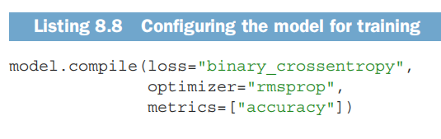
model hyper parameters specification

Slide 20
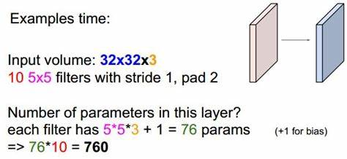
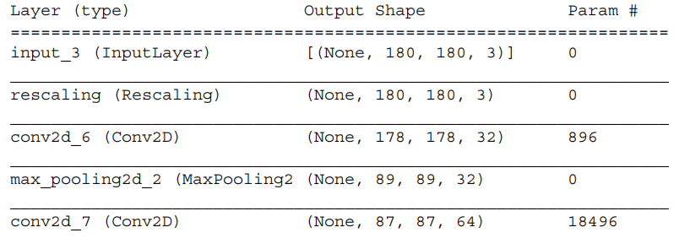
Calculating no. of Parameters
input channels=3
kernel size=3x3
filters=32
all multiples = 864
+bias (=#filters)=864+32=896
input channels=32
kernel size=3x3
filters=64
all multiples = 18432
+bias (=#filters)=18432+64=18496

Slide 21
Data Preprocessing
Read the picture files.
Decode the JPEG content to RGB grids of pixels.
Convert these into floating-point tensors.
Resize them to a shared size (e.g. 180 × 180).
Pack them into batches (e.g. batches of 32 images)
Fortunately Keras has utilities to take care of these steps automatically

Slide 22
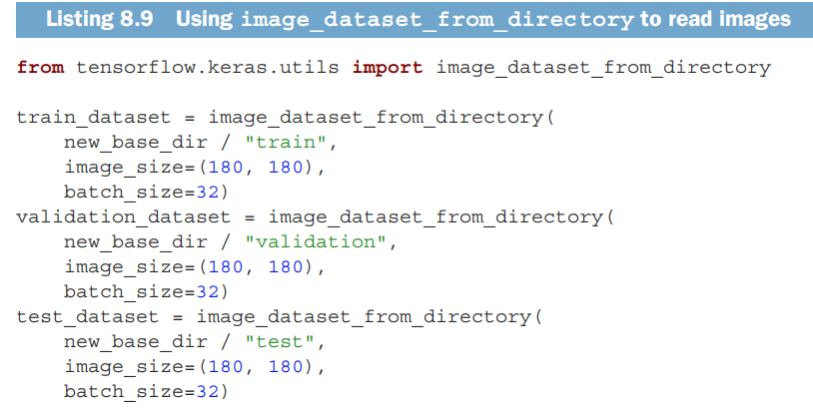
Keras built-in functionality reading images, resizing, batching

Slide 23
Keras Dataset Object
TensorFlow makes available the tf.data API to create efficient input pipelines for machine learning models.
Features asynchronous data prefetching (preprocessing the next batch of data while the previous one is being handled by the model)
common methods | when to use source
.image_dataset_from_directory() | data in directory structure
.from_tensor_slices() | data in numpy arrays
.flow_from_dataframe() | data paths mentioned in dataframe
.shuffle(buffer_size) | —Shuffles elements within a buffer
.prefetch(buffer_size) | —Prefetches a buffer of elements in GPU memory to achieve better device utilization.
.map(callable) | -- applying a function to dataset

Slide 24
HANDS On PRACTICE
Chose a Dataset
Create Directory Structure
Make dataset
Define Model
Evaluate
Data Augmentation
Repeat: Define Model, Evaluate
Repeat: Pre-trained Models, Extract Features, Define Model, Evaluate

Slide 25
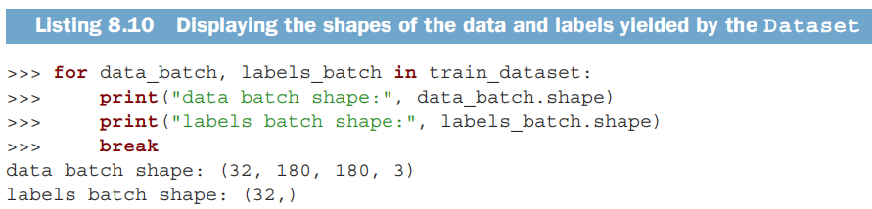
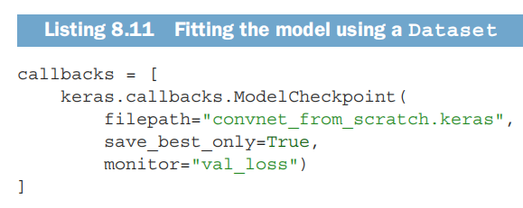
Checking the dataset , Callbacks

